Slide 1
Inheritance and interfaces
Review of Inheritance and Interfaces and Another Design Patterns

Slide 2
Review: What is Inheritance?
Inheritance is how a new class is created from an existing one.
One purpose of inheritance is to reuse existing classes.
Inherited variables and methods can be used in the derived class if they have been derived as public or protected in the superclass.
Inheritance creates an is-a relationship between all parent and child classes.

Slide 3
Visibility Modifiers and Multiple Inheritance
Visibility modifier determine which variable and methods, a child class can use; public and protected but not private variables and methods are visible in the child classes.
There is no multiple inheritance in Java (there is in C++). This means that you are unable to extend more than a single class.
The child of one class can be the parent of one or more other classes, creating a class hierarchy.

Slide 4
Overriding Methods
The child class can override the parent’s definition of an inherited method.
If a child has overridden a parent method, they may still access their parents method using the reserved word super.
super.message() will access their parents message method and message will access their own.
Common features should be located as high in a class hierarchy as is reasonably possible, minimizing maintenance efforts.

Slide 5
Review: What is an interface?
An interface is a collection of abstract methods. It cannot be instantiated.
A class implements an interface, which formally defines all of the methods defined in the interface. If it does not, it must be declared as abstract.
An example of an interface is Comparable in which it defines a compareTo method.
Any class that implements Comparable must implement the compareTo methods.

Slide 6
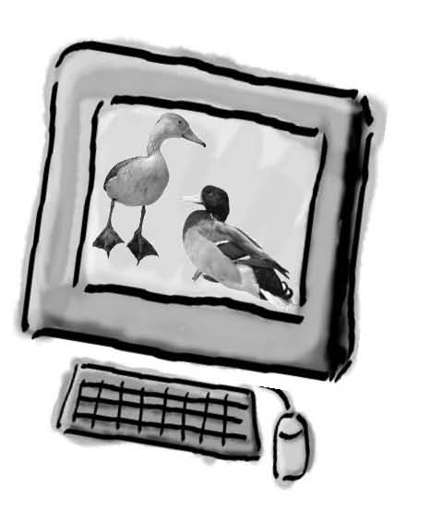
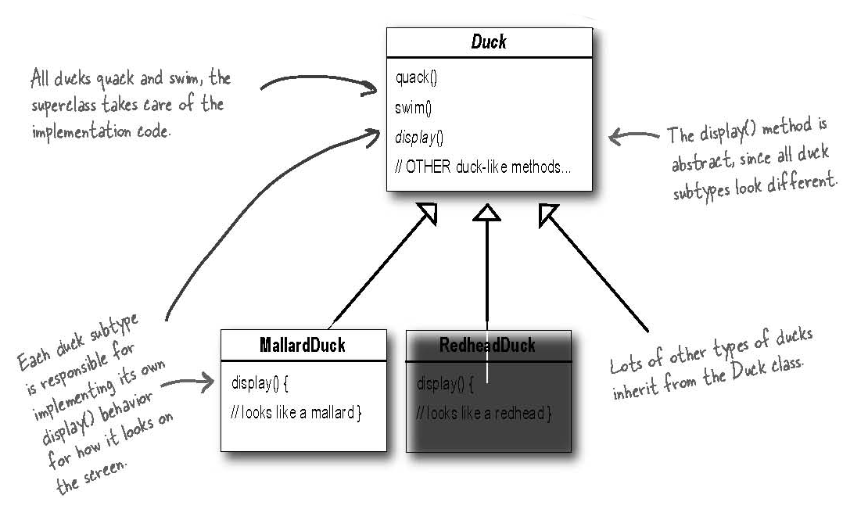
Sim-U-Duck

Slide 7
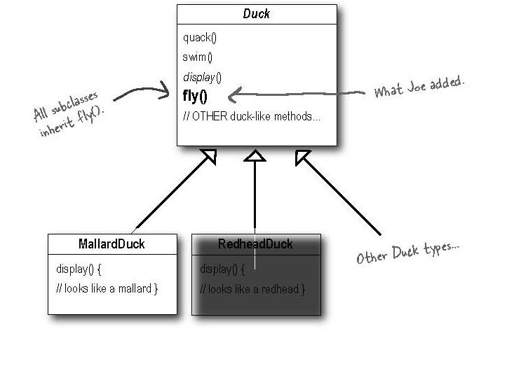
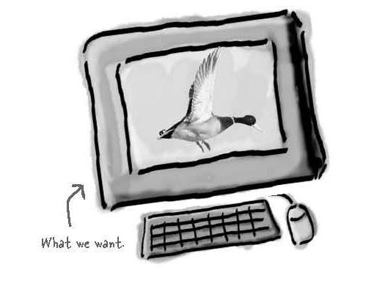
But Now we need ducks to fly!

Slide 8
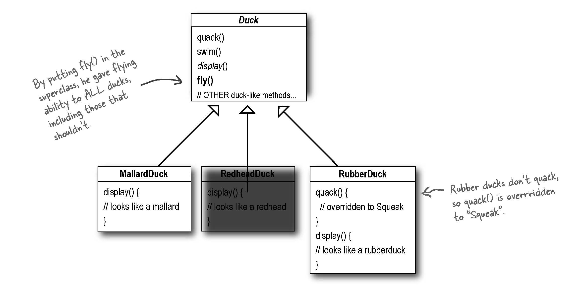
But Something went horribly wrong…

Slide 9
What Happened?
We failed to notice that not all Ducks should fly.
When we added new behavior to the superclass, we added behavior that was not appropriate for some Duck classes.
A localized update to the code caused a non-local side effect (flying rubber ducks)!
Adding fly to Duck is great for reuse but not great when it comes to maintenance.

Slide 10
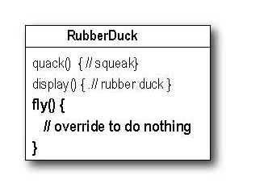
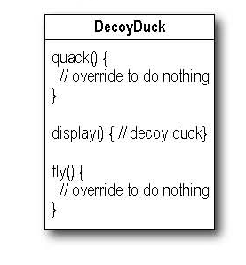
What about Overriding the fly method?
We could override the fly method in Rubber Duck to do nothing.
What happens when we add Wooden Duck Decoy?
It does not fly or quack?

Slide 11
Which are Disadvantages of using Inheritance to provide Duck Behavior?
Code is duplicated across subclasses.
Runtime behavior changes are difficult.
We can’t make ducks dance.
Hard to gain knowledge of all duck behaviors.
Ducks can’t fly and quack at the same time.
Changes can unintentionally affect other ducks.

Slide 12
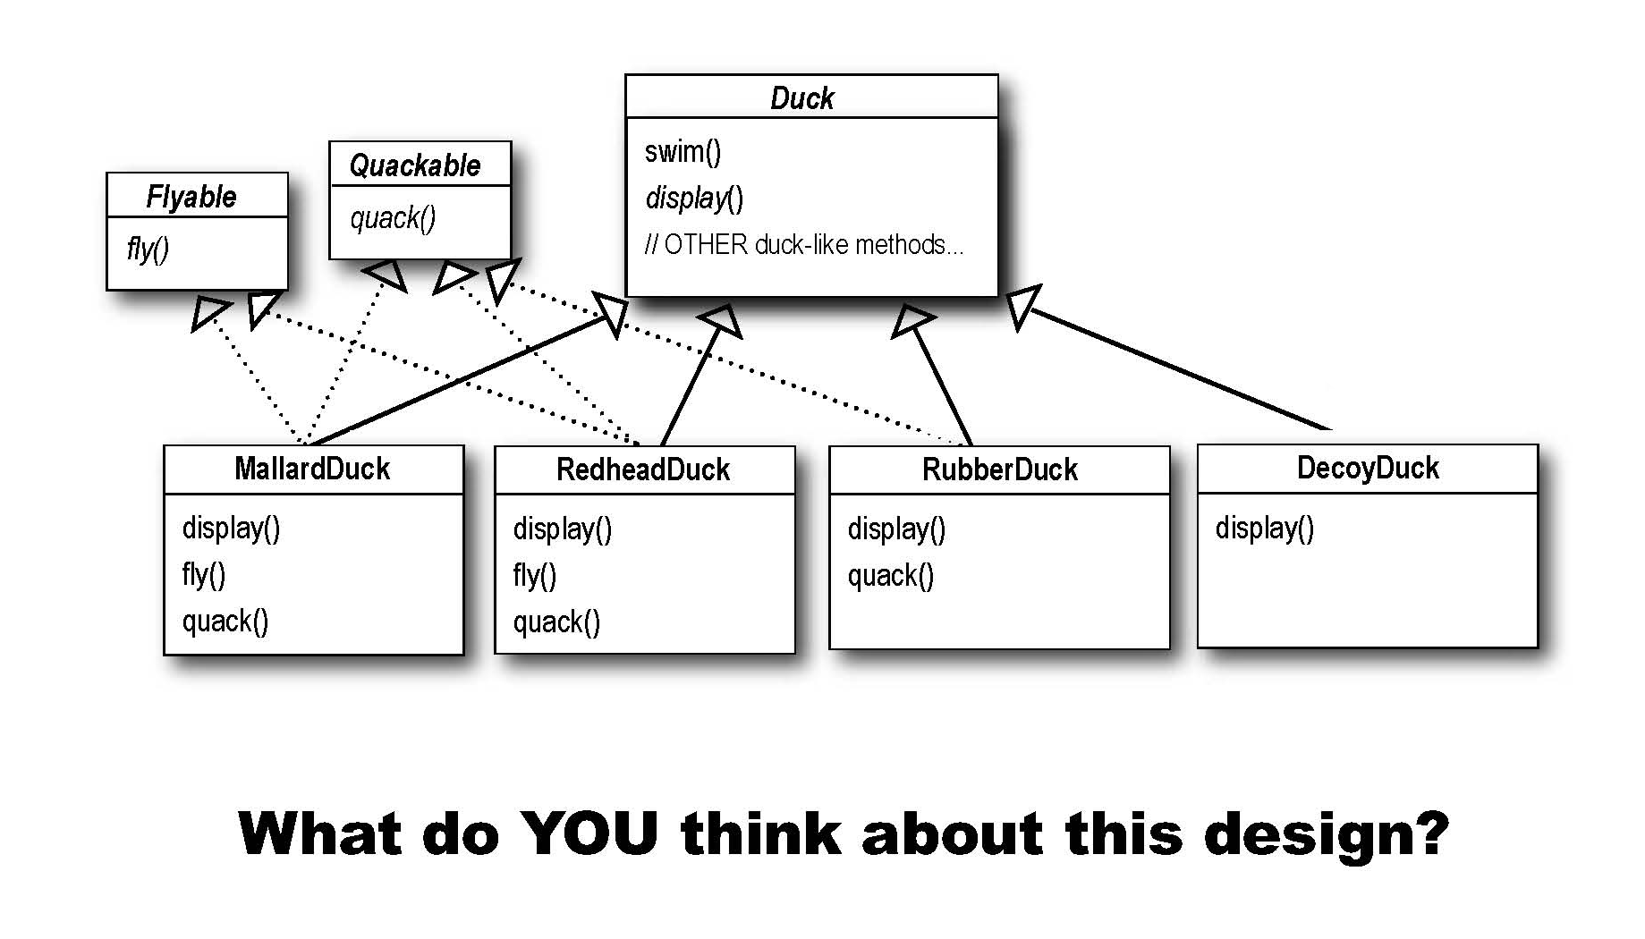
How about an Interface?

Slide 13
How about a Interface?
In the previous design we removed the fly and quack behaviors from the superclass and created interfaces for flyable and quackable – a duck could implement these if needed.
Duplicate Code – Every duck that needed to quack would need to implement the quackable interface and we would have many classes reimplementing the same code.
What if you have 48 difference ducks and then you needed to make a modification to the way flying works? Code reuse? Forget about it! Major maintenance nightmare!

Slide 14
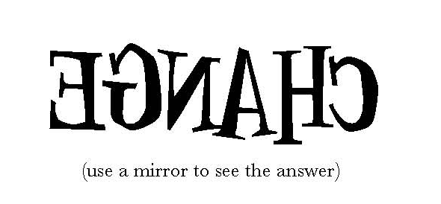
The one constant in Software Development

Slide 15
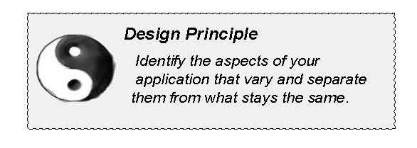
Zeroing in on the problem…
Take what varies and “encapsulate” it so it won’t affect the rest of your code.
The result? You can now alter or extend the parts that vary without affecting those that don’t.

Slide 16
Separate what changes from what stays the same
We know that fly() and quack() are the parts of the duck class that vary across ducks.
To separate the behaviors from the Duck class, we’ll pull both methods out of the Duck class and create a new set of classes to represent each behavior.

Slide 17
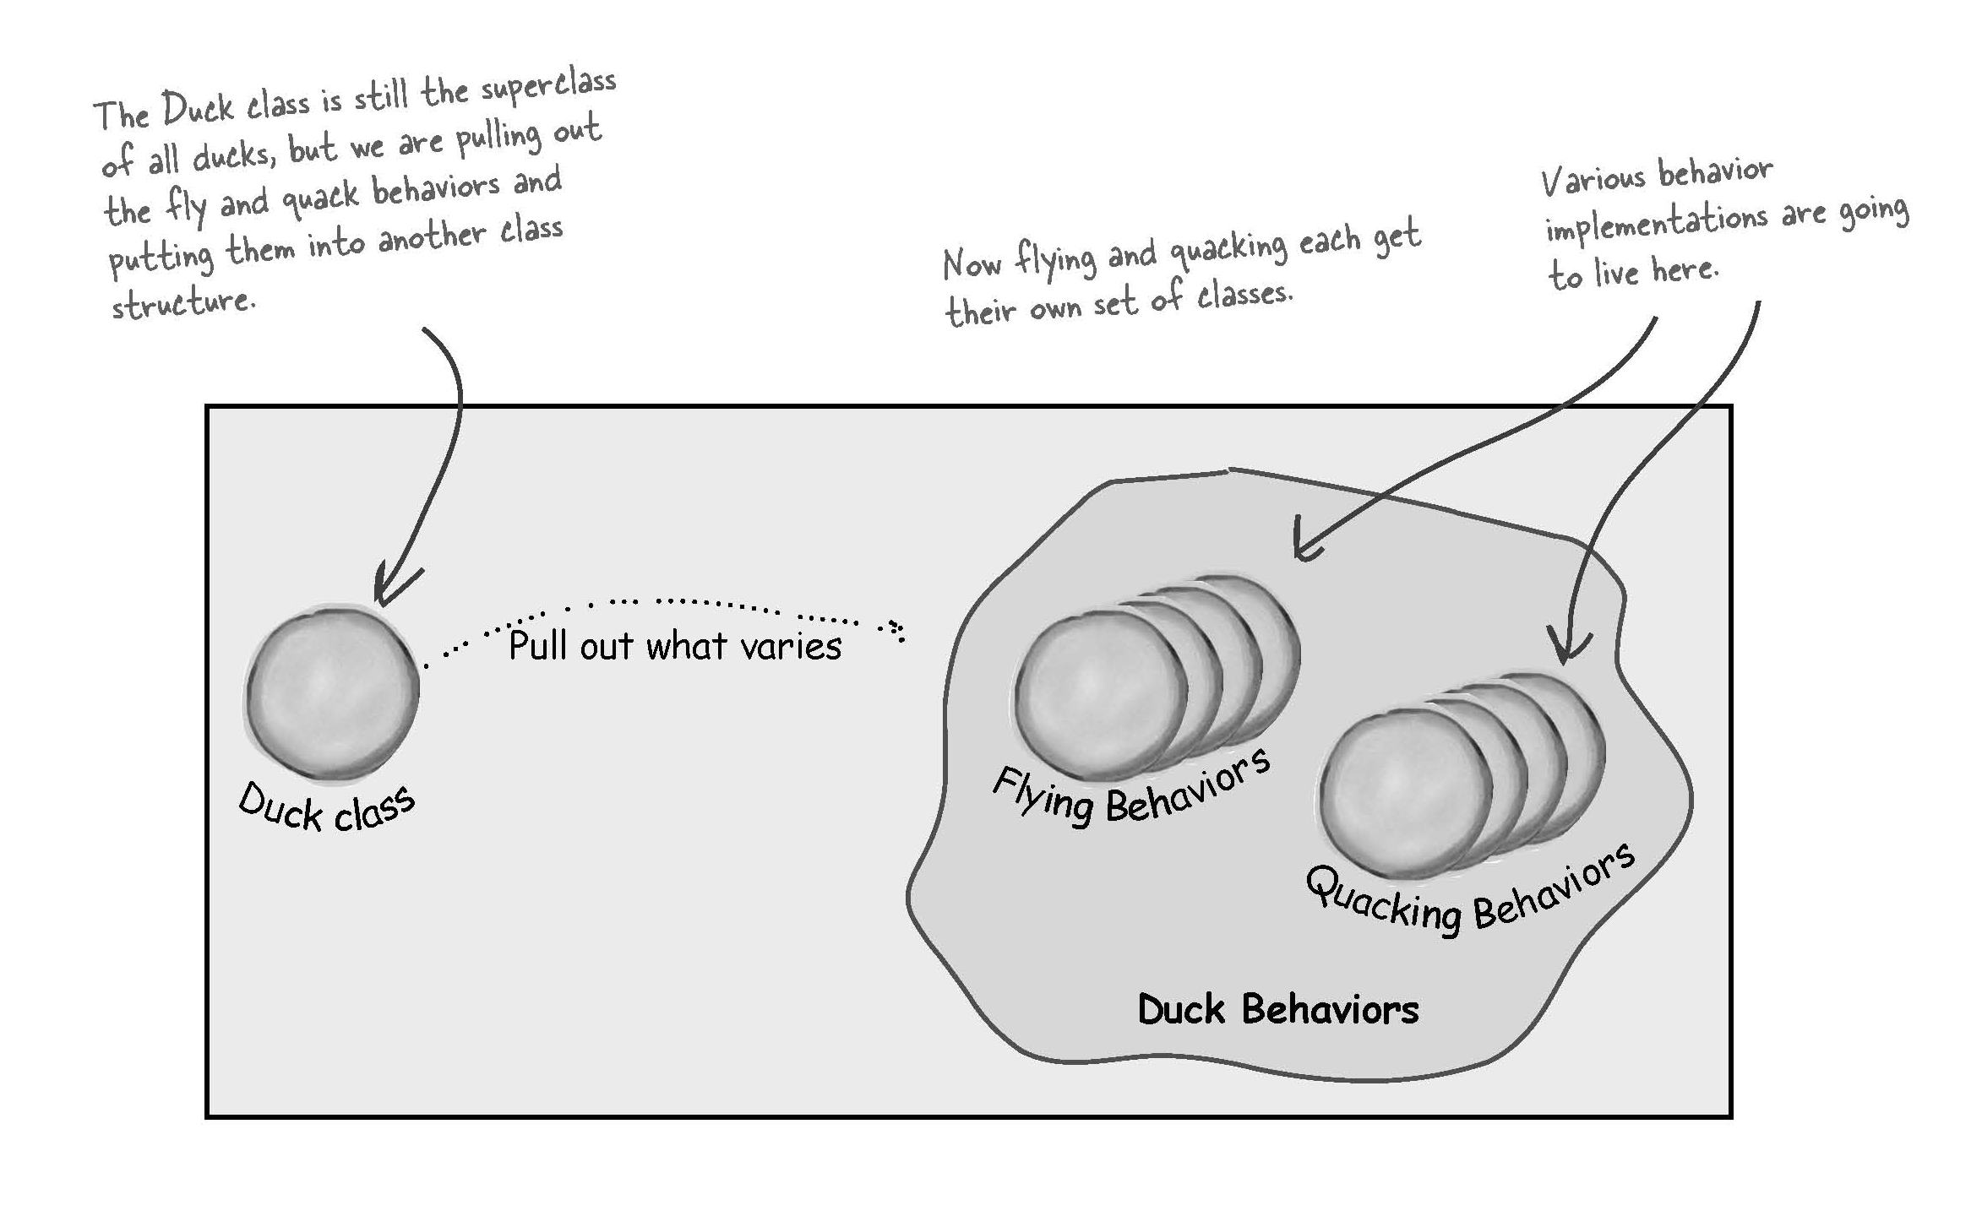
Separate what changes form what stays the same

Slide 18
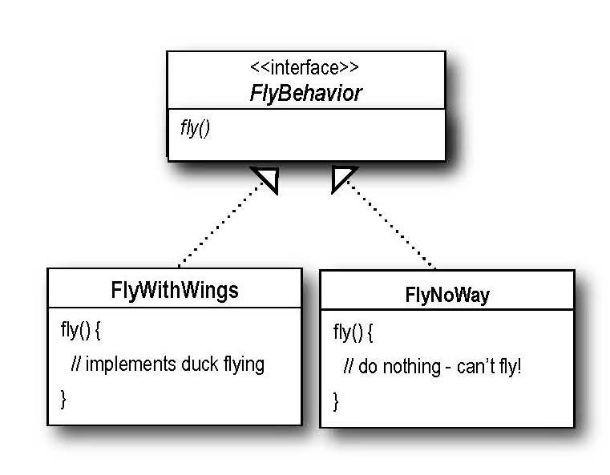
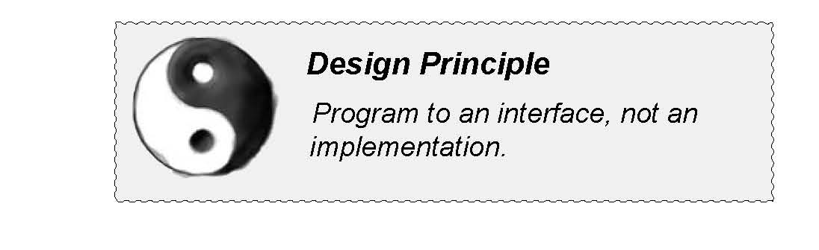
Designing the Duck Behaviors
From now on, the Duck behaviors will live in a separate class – a class that implements a particular behavior interface.
That way Duck classes won’t need to know any of the implementation details for their own behavior.

Slide 19
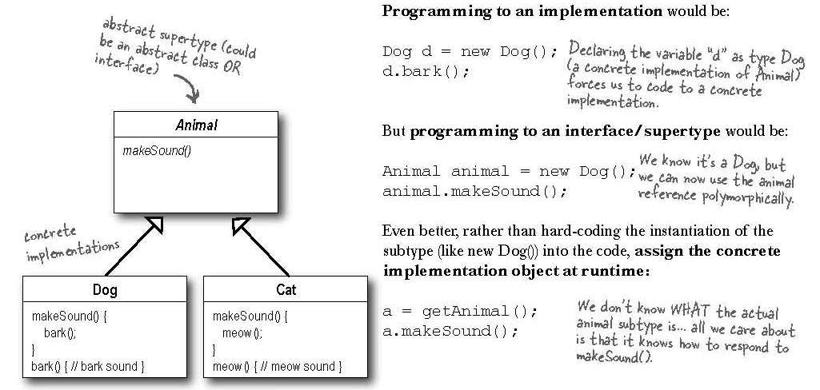
Program to an Interface

Slide 20
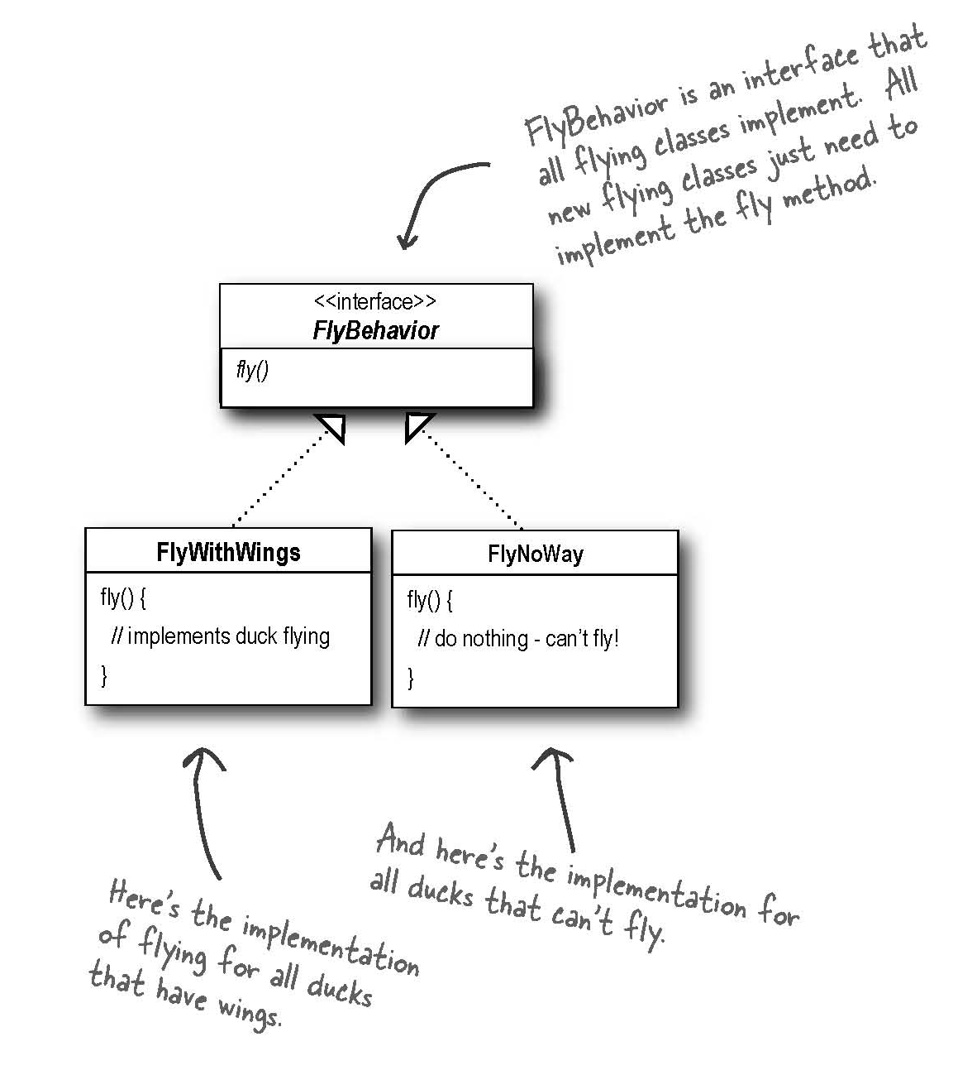
Implementing the Duck Behaviors

Slide 21
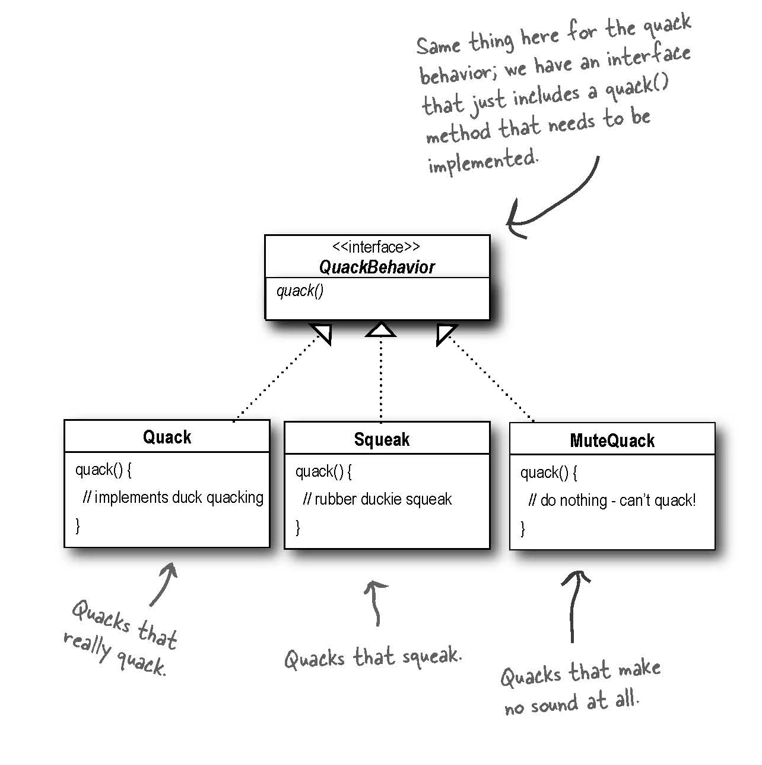
Implementing the Duck Behaviors

Slide 22
Implementing the Duck Behaviors
With this design, other types of objects can reuse our fly and quack behaviors because these behaviors are no longer hidden away in our Duck classes!
And we can add new behaviors without modifying any of our existing behavior classes or touching any of the Duck classes that use flying behaviors.
So we get the benefit of reuse without all the baggage that comes along with inheritance

Slide 23
Should Duck be an Interface too?
Not in this case. There are some common features like properties and methods that are inherited.
Not that we have removed what varies from the Duck inheritance, we get the benefits of this structure without the maintenance problems.

Slide 24
Questions
What would you do if you wanted to add “rocket-powered flying”?
Create a FlyRocketPowered class that implements the Flyable interface
Can you think of a class that might want to use the Quack behavior that isn’t a duck?
A duck call – a device that makes duck sounds

Slide 25
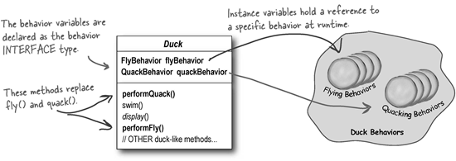
Integrating the Duck Behavior
The key to using our design is that a Duck will now delegate its flying and quacking behavior, instead of using quacking and flying methods defined in the Duck class (or subclass).

Slide 26
Now we Implement performQuack()
public class Duck {
QuackBehavior quackBehavior;
// more
public void performQuack() {
quackBehavior.quack();
}
}
Each Duck has a reference to something that implements the QuackBehavior
Rather than handling the quack behavior itself, the Duck delegates that behavior to the object referenced by quackBehavior.

Slide 27
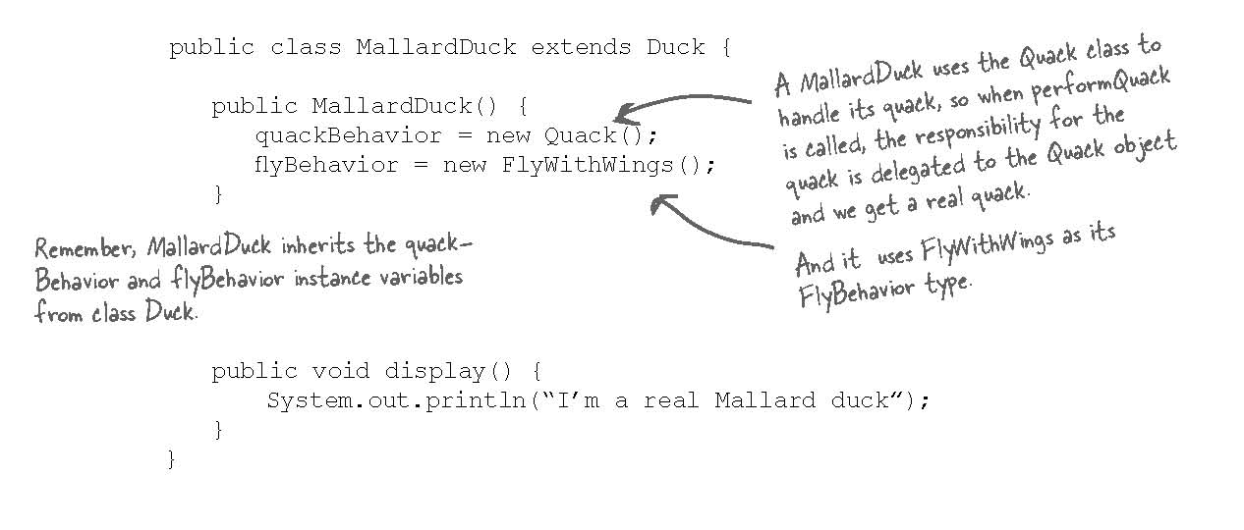
How do we set the Behaviors?

Slide 28
Whoa… Did we not just program to an implementation?
When we wrote the constructor and set the behavior we were programming an implementation.
This is still better than before and if we want we can come up with a way to change these behaviors at runtime.
HOW?
Create setters for the behaviors!!!

Slide 29
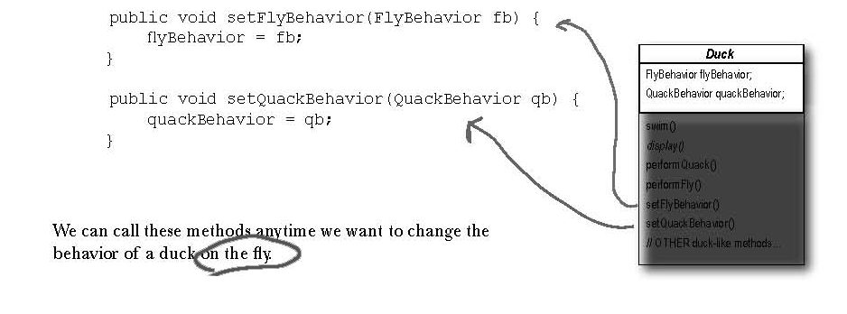
Setting the Behaviors Dynamically
Add two new methods to the Duck class:

Slide 30
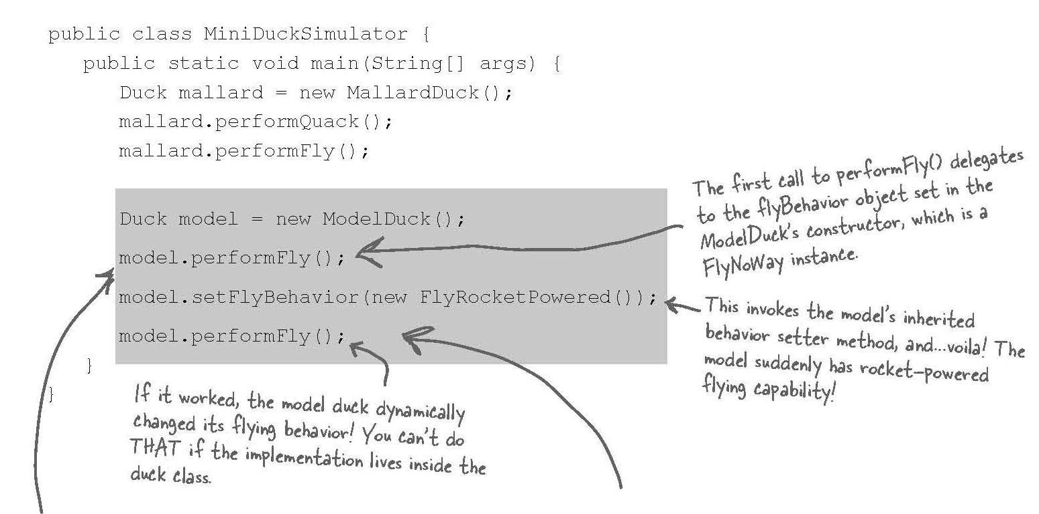
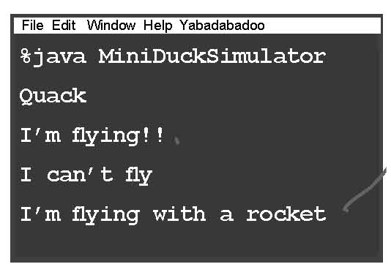
Using our New Design

Slide 31
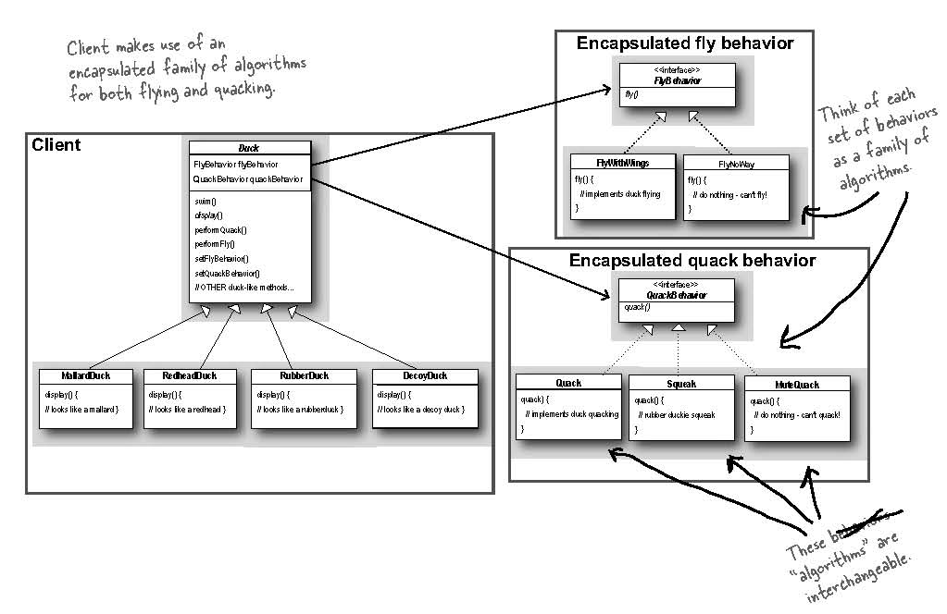
The Big Picture

Slide 32
Has-A can be better than IS-A
The HAS-A relationship is an interesting one: each duck has a FlyBehavor and a QuackBehavior to which it delegates flying and quacking.
When you have two classes like this you are using composition.
Composition allows you to encapsulate a family of algorithms.
We can now also change the behavior at runtime.

Slide 33
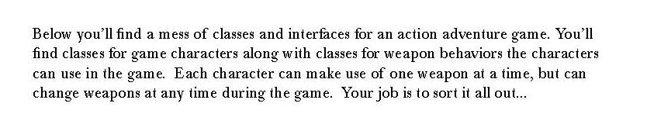
Design Puzzle

Slide 34
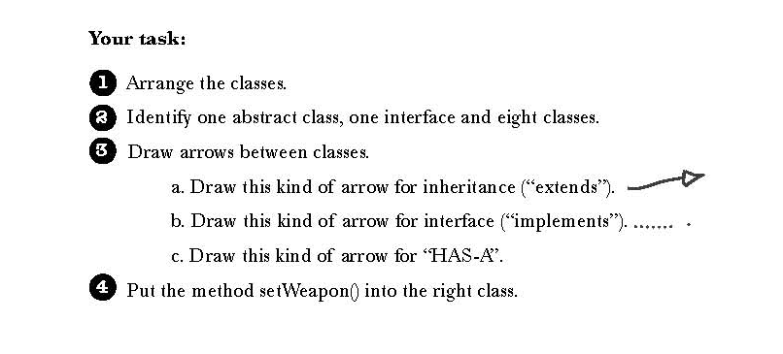
Design Puzzle

Slide 35
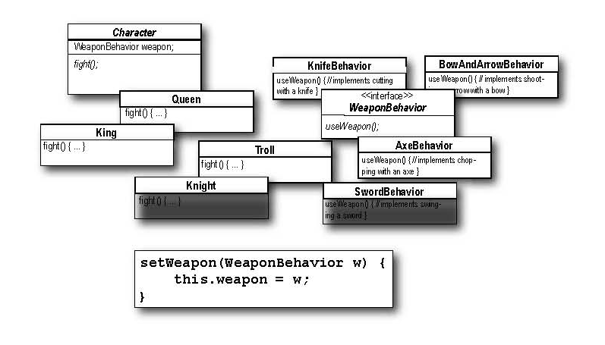
Design Puzzle

Slide 36
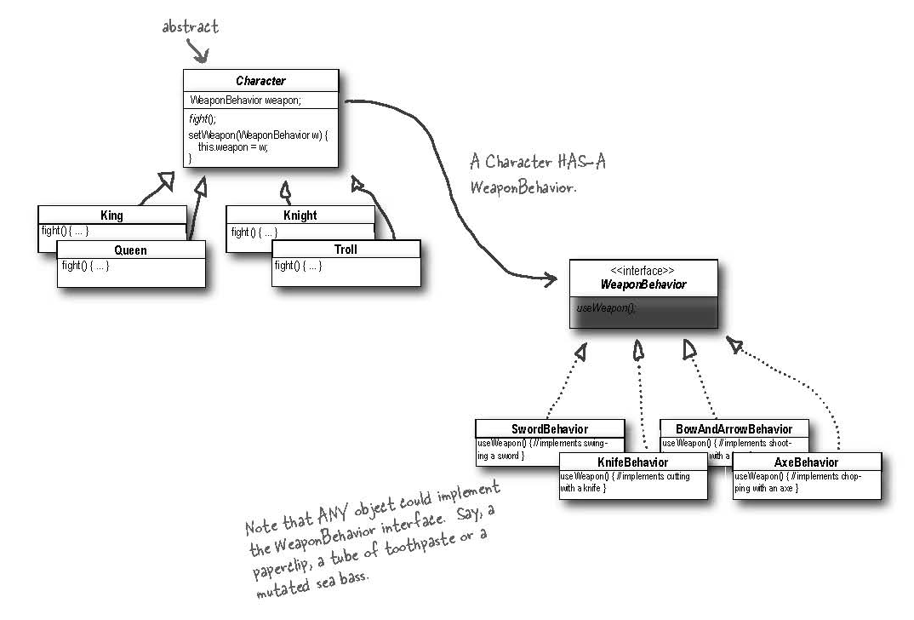
Design puzzle: Solution

